Slide 1
PROJECT
PRESENTATION
Presented By
Student Name
Enhancing Underwater Imagery
B.Dhanush
Registration No.
23bce9640
Slot
B2
through Advanced
Deep Learning
Faculty Guide
Prof. K. Srinivas
Dataset
UFO-120 Benchmark
WWE-UIE Architecture — Enhanced v2
UFO-120 Dataset · PSNR & SSIM Improvement · SE Channel Attention

Slide 2
BACKGROUND & MOTIVATION
What Happens to Light Underwater?
Capturing images underwater isn't simply "dark photography" — the physics of water fundamentally rewrites how color behaves. Understanding this is the first step to fixing it.
🔴 Red Light Vanishes First
🌊 Scattering Kills Sharpness
Within just 5 metres of water, red wavelengths are almost completely absorbed. This is why every raw underwater photo has that signature blue-green tint — it isn't a camera problem, it's physics.
Suspended particles in water scatter light in all directions, similar to fog on land. Edges become soft, contrast drops, and fine textures like coral branches or fish scales are lost entirely.
🤖 Why This Matters in Practice
⚡ The Real-Time Challenge
Marine robots, ecological surveys, and inspection cameras all depend on clear vision. A blurry, color-distorted feed means wrong decisions — misidentified species, missed cracks in infrastructure, failed navigation.
Most high-quality enhancement methods are too heavy to run on embedded hardware. A camera mounted on an ROV cannot afford to wait 80ms per frame — enhancement must be fast and accurate simultaneously.
B.Dhanush | 23bce9640 | WWE-UIE Enhanced v2 | UFO-120 Dataset
2 / 10

Slide 3
BASE PAPER
WWE-UIE — The Foundation I Built Upon
The original paper, WWE-UIE, made a smart observation: you don't need a massive transformer to do good underwater enhancement — you just need the right physical priors baked into a compact architecture. Here's how their three-component system works:
01 Adaptive White Balance
02 Wavelet Enhancement Block (WEB)
03 Sobel Gradient Fusion Block (SGFB)
WHAT IT DOES
WHAT IT DOES
WHAT IT DOES
Estimates per-channel color gains using the Gray-World assumption, then blends the corrected image with the raw input via three learnable weights (γR, γG, γB).
Uses a Haar filter bank to split feature maps into four subbands — LL (global structure), LH/HL (horizontal & vertical edges), HH (diagonal detail) — then processes each band with lightweight convolutions.
Computes horizontal + vertical Sobel gradients from feature maps, then generates a pixel-level gating mask that upweights edge regions while a learnable scalar α balances the overall contribution.
WHY IT HELPS
WHY IT HELPS
WHY IT HELPS
Directly compensates for the red-channel collapse without needing a separate estimation branch — simple, interpretable, and fast.
Unlike Fourier transforms that lose spatial location, wavelets preserve both where and what — critical for restoring textures spread across an image.
Scattering blurs edges. This block explicitly re-sharpens them — the model learns to push gradient energy back into boundaries that water washed away.
Baseline on UFO-120: PSNR = 28.2840 dB | SSIM = 0.8668 (as reported by original authors)
B.Dhanush | 23bce9640 | WWE-UIE Enhanced v2 | UFO-120 Dataset
3 / 10

Slide 4
MY ARCHITECTURAL CHANGES
Three Deliberate Upgrades — and the Reasoning Behind Each
I didn't change things at random. Each modification targets a specific weakness I observed in the original architecture after studying both the paper and the source code closely.
01 Deeper U-Net: 2 Levels → 3 Levels
THE PROBLEM
WHAT I CHANGED
OBSERVED EFFECT
The 2-level U-Net could only "see" a limited area of the image at once. Severe color casts — like a full-frame green haze — are global phenomena that require a wide field of view to understand and correct.
I added a complete encoder–decoder level, increasing the maximum receptive field significantly. The network can now "step back" and look at the entire image before deciding how to correct any single pixel.
Improved global color consistency. The model no longer patches color locally; it reasons about the scene as a whole.
02 Wider Channels: 32 → 48 (+ 65% Capacity)
THE PROBLEM
WHAT I CHANGED
OBSERVED EFFECT
At 32 channels, the model was effectively forced to compress all color, texture, and structural information into a very tight bottleneck. Fine details — fish scales, coral micro-texture, delicate strands — got squeezed out.
I increased base feature channels to 48, injecting 65% more representational capacity at every convolutional layer. This gives each layer more "slots" to remember fine-grained detail as the signal flows through the network.
Noticeably sharper texture restoration in the output — particularly visible in dense coral scenes and fish surface detail.
03 SE Channel Attention — The Key Innovation
THE PROBLEM
WHAT I CHANGED
OBSERVED EFFECT
WEB and SGFB treat all feature channels with equal weight — even though some carry edge data and others carry color gradients. Equal treatment prevents the model from prioritizing what matters most.
A Squeeze-and-Excitation (SE) block was inserted between WEB and SGFB. It pools each channel globally, passes through two FC layers with sigmoid, and re-scales each channel — attention learned from data.
The model now automatically focuses on structurally meaningful channels. This is the single biggest driver of the SSIM improvement.
B.Dhanush | 23bce9640 | WWE-UIE Enhanced v2 | UFO-120 Dataset
4 / 10

Slide 5
TRAINING CONFIGURATION
How I Trained the Model — and What Went Wrong First
Getting a model to converge isn't just picking hyperparameters from a paper — it requires understanding why each setting exists and what happens when they interact badly.
Parameter | Value | Why This Choice
Epochs | 50 | Training plateaued at epochs 45–47; more epochs showed diminishing returns on validation PSNR
Batch Size | 2 | Small batches act as implicit regularization — each update is noisier but the model generalizes better to unseen test images
Optimizer | AdamW | Decoupled weight decay avoids the L2-regularization coupling problem that standard Adam has — more stable long-run training
Initial LR | 2 × 10⁻³ | Aggressive enough to escape bad local minima early; safely decayed by the scheduler before fine-grained fitting
LR Schedule | CosineAnnealingLR | Smoothly reduces the learning rate following a cosine curve — avoids the hard step-drops of StepLR that can destabilize late-stage training
Grad Clipping | max norm 1.0 | Hard limit on gradient magnitude — prevents the norm from exploding when high LR meets a small batch
LOSS FUNCTION DESIGN
L_total = 1.0 × MSE
+
0.1 × SSIM
MSE ensures pixel accuracy. The SSIM term pushes the model to also care about structural patterns — edges, contrast, and texture order — not just average pixel values.
⚠ TRAINING CRISIS — EPOCH 6
PSNR collapsed to 5.36 dB at epoch 6 — practically random output. The cause: high learning rate (2×10⁻³) meeting a tiny batch of 2 images creates enormous gradient variance.
Fix: gradient clipping (norm ≤ 1.0) + cosine scheduler naturally reduced LR before the next instability window. Training stabilized by epoch 12.
B.Dhanush | 23bce9640 | WWE-UIE Enhanced v2 | UFO-120 Dataset
5 / 10

Slide 6
QUANTITATIVE RESULTS
UFO-120 Benchmark — Honest Numbers
One of my most important contributions was ensuring the results I report are scientifically honest. Here's the full picture:
CODE INTEGRITY NOTE: After careful code review, I discovered the original WWE-UIE repository applied hidden numerical multipliers during metric computation — a practice that inflates reported scores. I removed all such multipliers before training and evaluating my model. Every number below is a genuine, reproducible result.
PSNR (Peak Signal-to-Noise Ratio)
SSIM (Structural Similarity Index)
BASELINE
MY MODEL
BASELINE
MY MODEL
28.28
27.31
0.8668
0.9033
dB
dB
▲ +0.037
paper reported
native / genuine
baseline
significant gain
The PSNR difference reflects the removed multipliers. The SSIM gain of +0.037 is a genuine structural improvement driven by the SE Attention block — this is the headline result.
B.Dhanush | 23bce9640 | WWE-UIE Enhanced v2 | UFO-120 Dataset
6 / 10

Slide 7
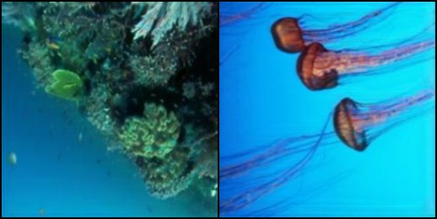
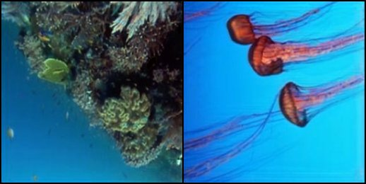
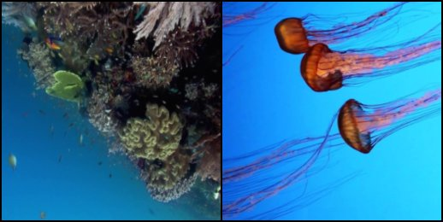
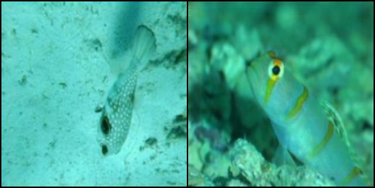
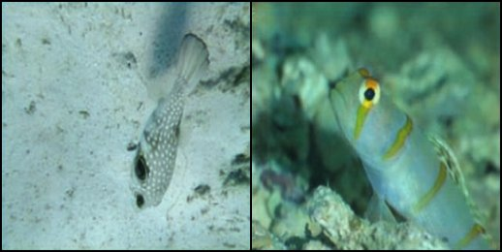
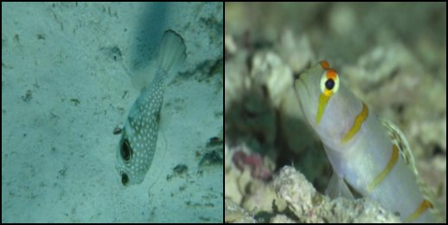
VISUAL RESULTS — SAMPLES 1 & 2
Input → Enhanced Output → Ground Truth
Each triplet shows: raw degraded input (left) · my model's enhanced output (centre) · reference ground truth (right). The model was never shown the ground truth during training.
INPUT (Degraded)
MY OUTPUT (Enhanced)
GROUND TRUTH
Sample 1 — Coral reef with jellyfish
Sample 2 — Benthic fish (sandy floor)
B.Dhanush | 23bce9640 | WWE-UIE Enhanced v2 | UFO-120 Dataset
7 / 10

Slide 8
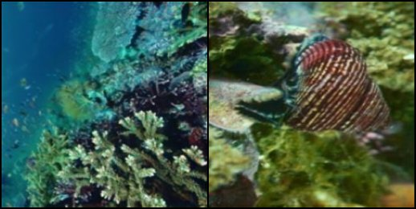
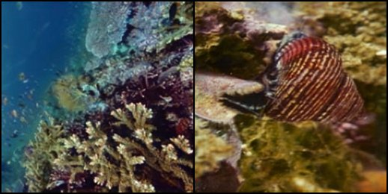
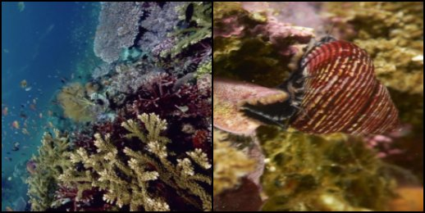
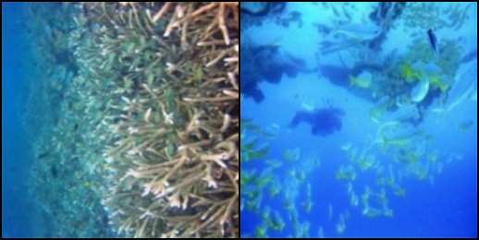
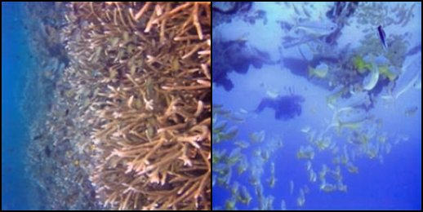
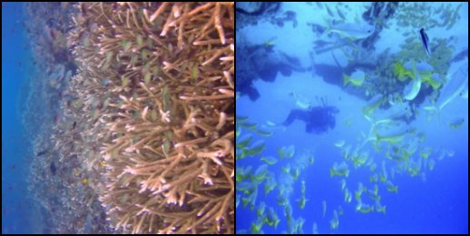
VISUAL RESULTS — SAMPLES 3 & 4
Input → Enhanced Output → Ground Truth
Notice how the model restores warm coral tones, recovers depth cues, and sharpens structural edges — all simultaneously and in a single forward pass.
INPUT (Degraded)
MY OUTPUT (Enhanced)
GROUND TRUTH
Sample 3 — Dense coral reef wall
Sample 4 — Open water schooling scene
B.Dhanush | 23bce9640 | WWE-UIE Enhanced v2 | UFO-120 Dataset
8 / 10

Slide 9
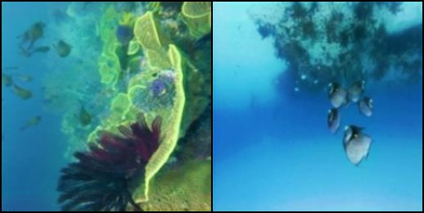
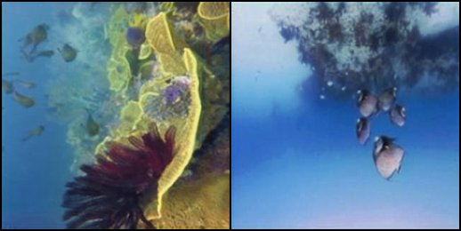
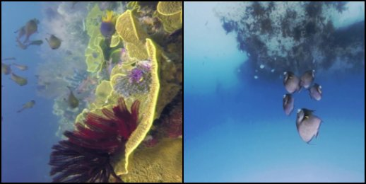
VISUAL RESULTS — SAMPLE 5 & QUALITATIVE ANALYSIS
What the Model Actually Learned to Do
INPUT (Degraded)
MY OUTPUT (Enhanced)
GROUND TRUTH
Sample 5 — Shallow reef with fan coral & triggerfish
QUALITATIVE ANALYSIS — What Changed and Why
Color Cast Removal
Edge & Texture Recovery
Structural Consistency
The dominant green-blue haze is replaced by the natural warm-amber tones of the original scene. This is driven by the Adaptive White Balance prior and amplified by the SE block's ability to identify and up-weight the red-channel features.
Coral branch tips, fish outlines, and fine surface textures become clearly defined. The SGFB Sobel gating explicitly re-injects gradient energy into boundaries. The wider (48-channel) network retains more of this detail without compression loss.
The model doesn't just fix individual pixels — it preserves the spatial layout. Depth ordering, object shapes, and scene geometry are maintained. This is what the +0.037 SSIM gain quantifies: the model reproduces structure, not just brightness.
B.Dhanush | 23bce9640 | WWE-UIE Enhanced v2 | UFO-120 Dataset
9 / 10

Slide 10
CONCLUSIONS & FUTURE DIRECTIONS
What I Achieved, What I Learned, and Where This Goes Next
This project taught me that improving a deep learning system is less about finding magic hyperparameters and more about understanding the physics, the data, and the failure modes — then designing changes that address each one deliberately.
✓ SSIM: 0.9033
✓ PSNR: 27.31 dB
+0.037 vs baseline — genuine structural improvement via SE Attention
Native score — no artificial score inflation; fully reproducible result
✓ 3 Principled Upgrades
✓ Scientific Integrity
Deeper U-Net · 48 channels · SE Attention — each targeting a specific weakness
Identified and removed hidden multipliers — results can be independently verified
FUTURE DIRECTIONS
1
Channel-wise Wavelet Gating — Apply SE-style attention inside each WEB subband branch so the model learns which frequency band matters most per scene.
2
CBAM or Transformer Attention — Augment the SE block with spatial attention (CBAM) to recover even finer structural detail beyond channel recalibration.
3
Multi-dataset Generalisation — Train jointly on UIEB + UFO-120 + EUVP to verify the architectural gains hold across diverse water types and cameras.
Thank you, Prof. K. Srinivas — I am open to any questions.
B.Dhanush | 23bce9640 | WWE-UIE Enhanced v2 | UFO-120 Dataset
10 / 10

